Slide 1



PROBIT:
What happens, when you combine behaviour of production users, Test Automation and AI
Powered by
Notes:
Lukas starts: Hello all: We are here to present the cooperation between our test-competence-center and Probit. Why do we use probit, what is it, and where lies the future. What happens, when you combine behaviour of production users, Test Automation and AI?

Slide 2
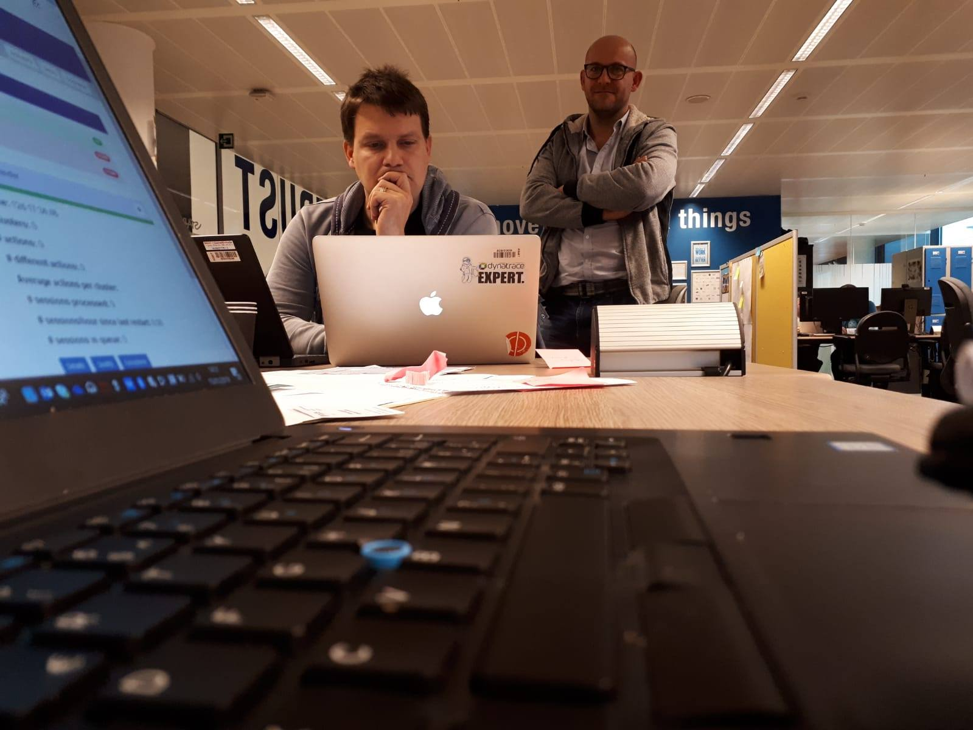
Notes:
Thomas: This is where Probit found it existence: in the Surfstudio in the basement of KBC (wll, actually, the idea itself was thought of in a nearby café over a duvel)

Slide 3

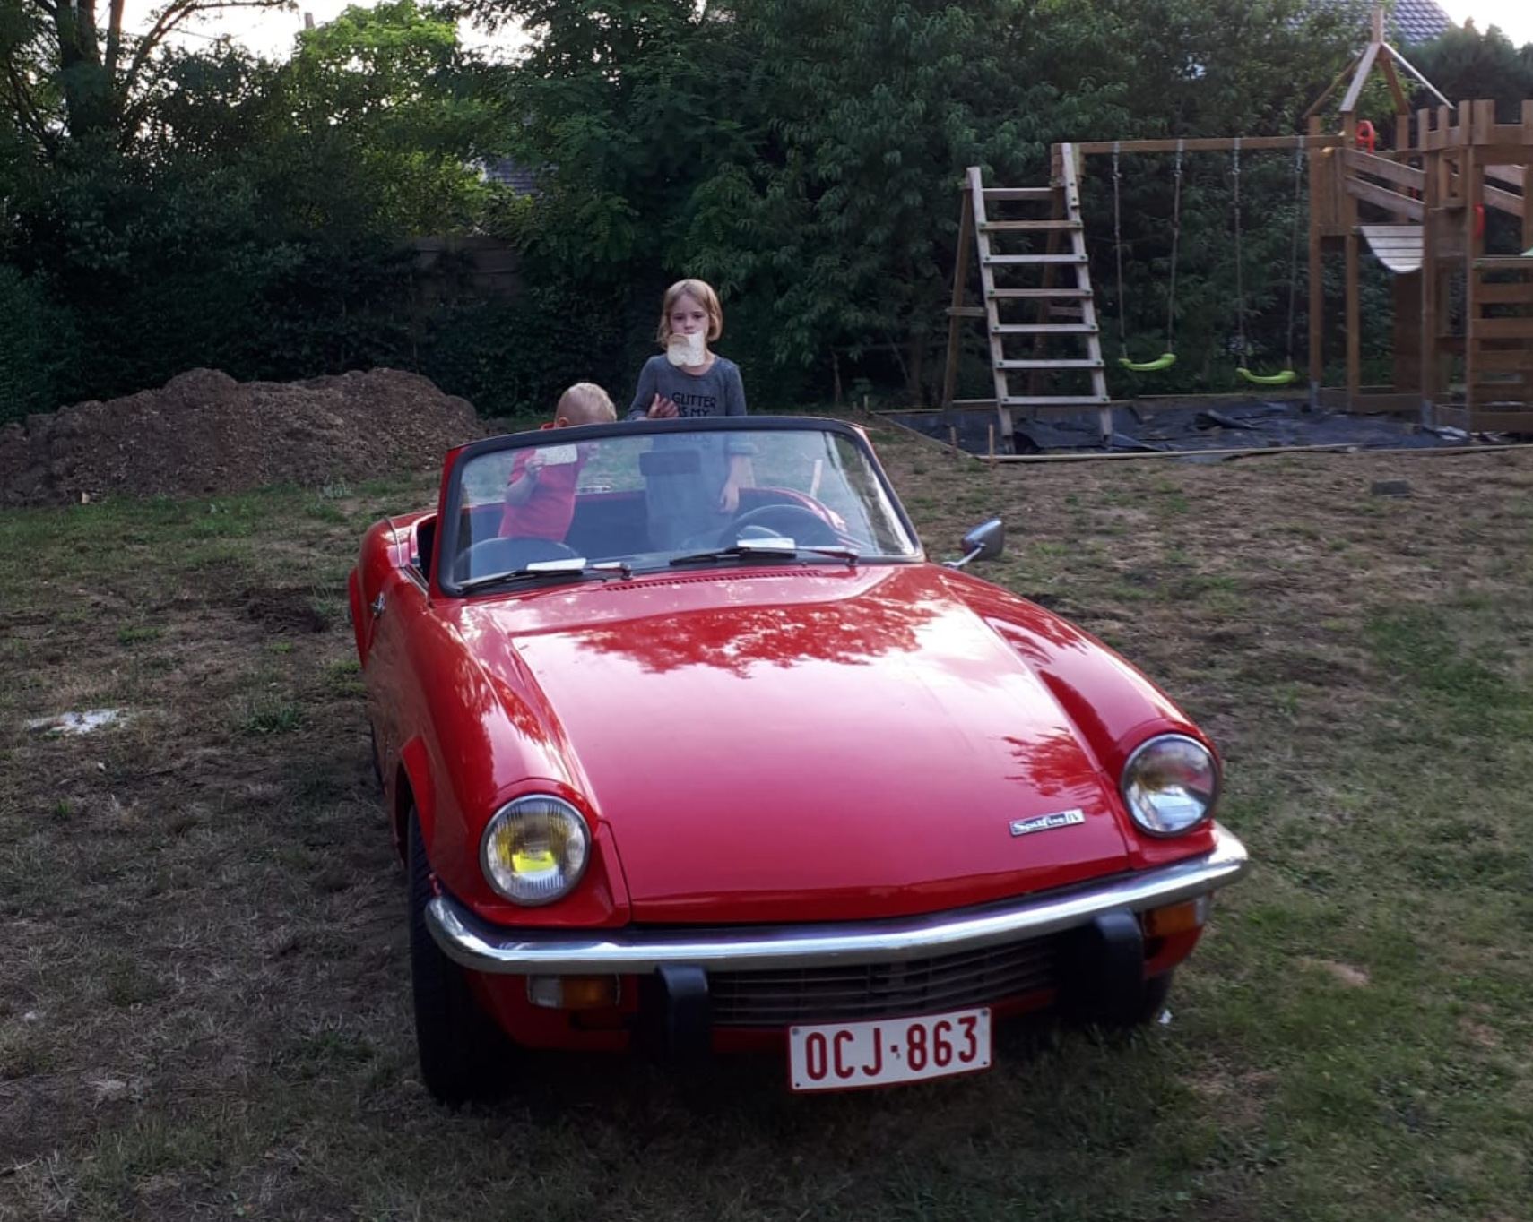


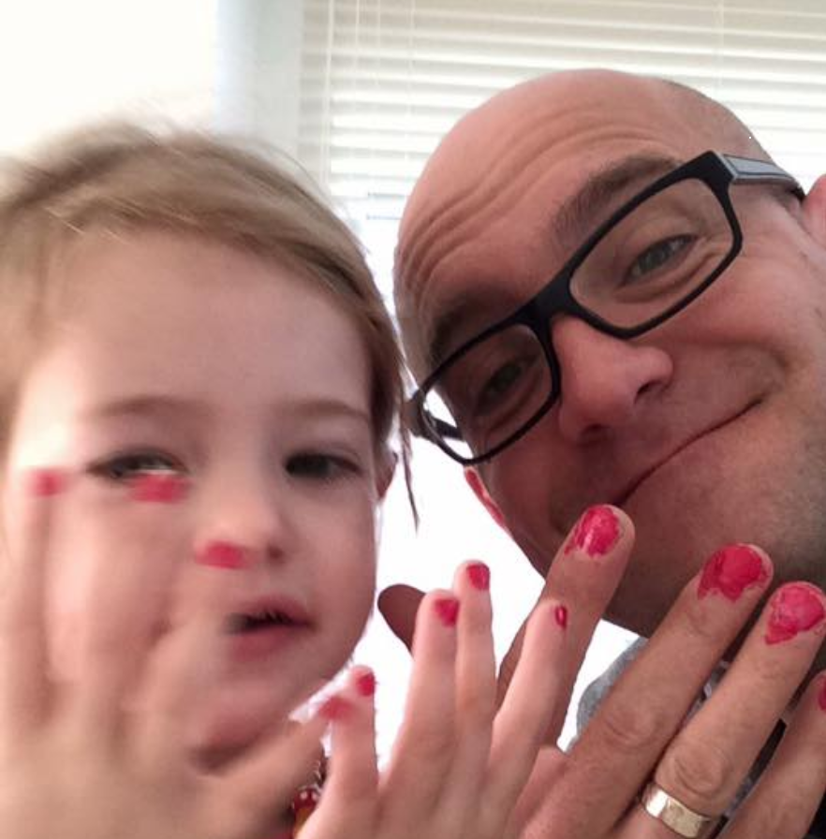
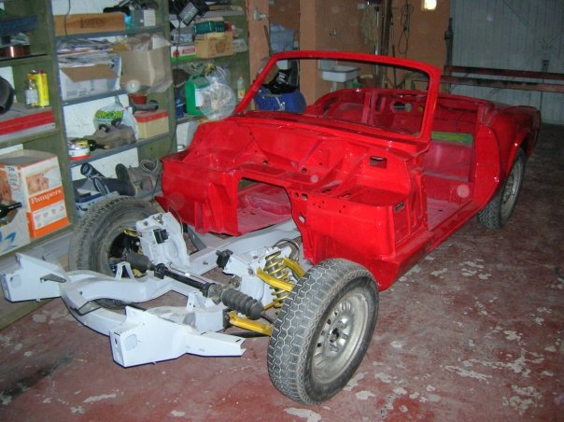
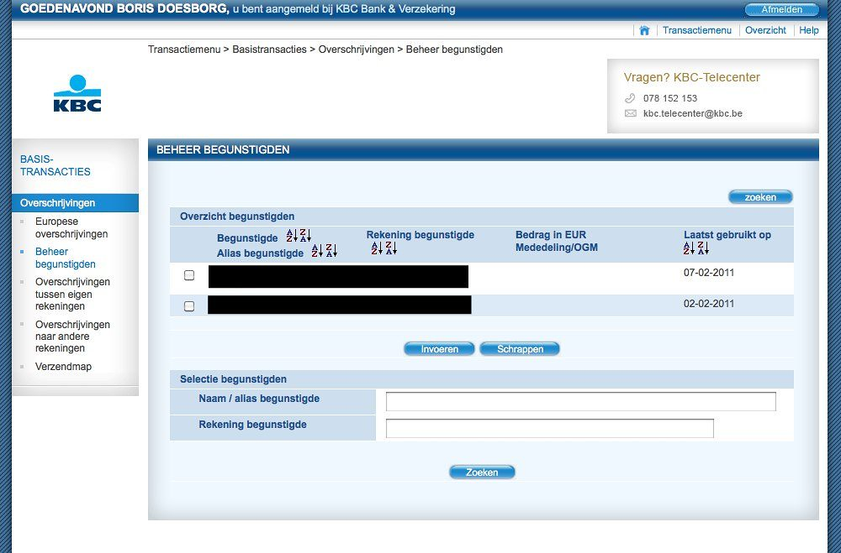

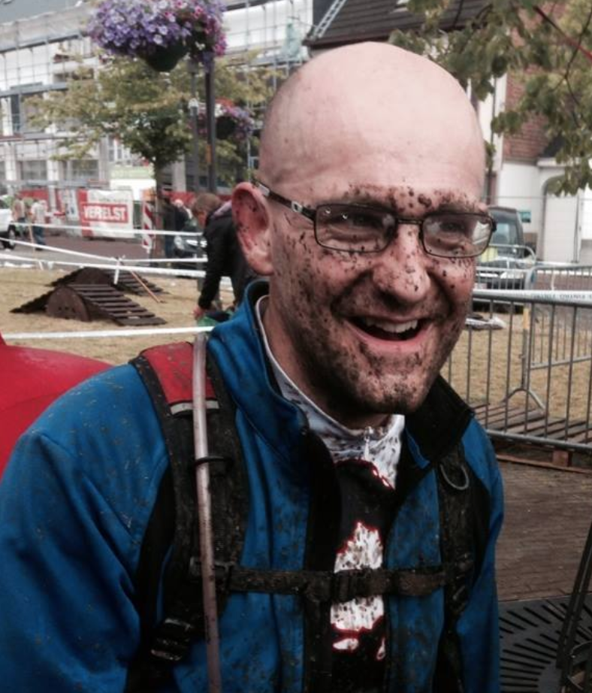

Frederik Byl
Notes:
Frederik: I am Frederik, cofounder of Probit, i worked for some other companies like ING, Argenta - Banks - and for Logica as a consultant; At KBC i worked for Online, Touch, Mobile and security, but currently for discovery labs. I like to get dirty, specially on my car; a spitfire from 1891. but i have most fun is i can play with my kids. Lou (5 years old) and Felix (2 years old).

Slide 4
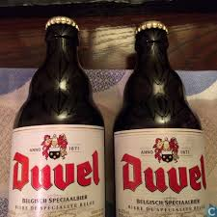

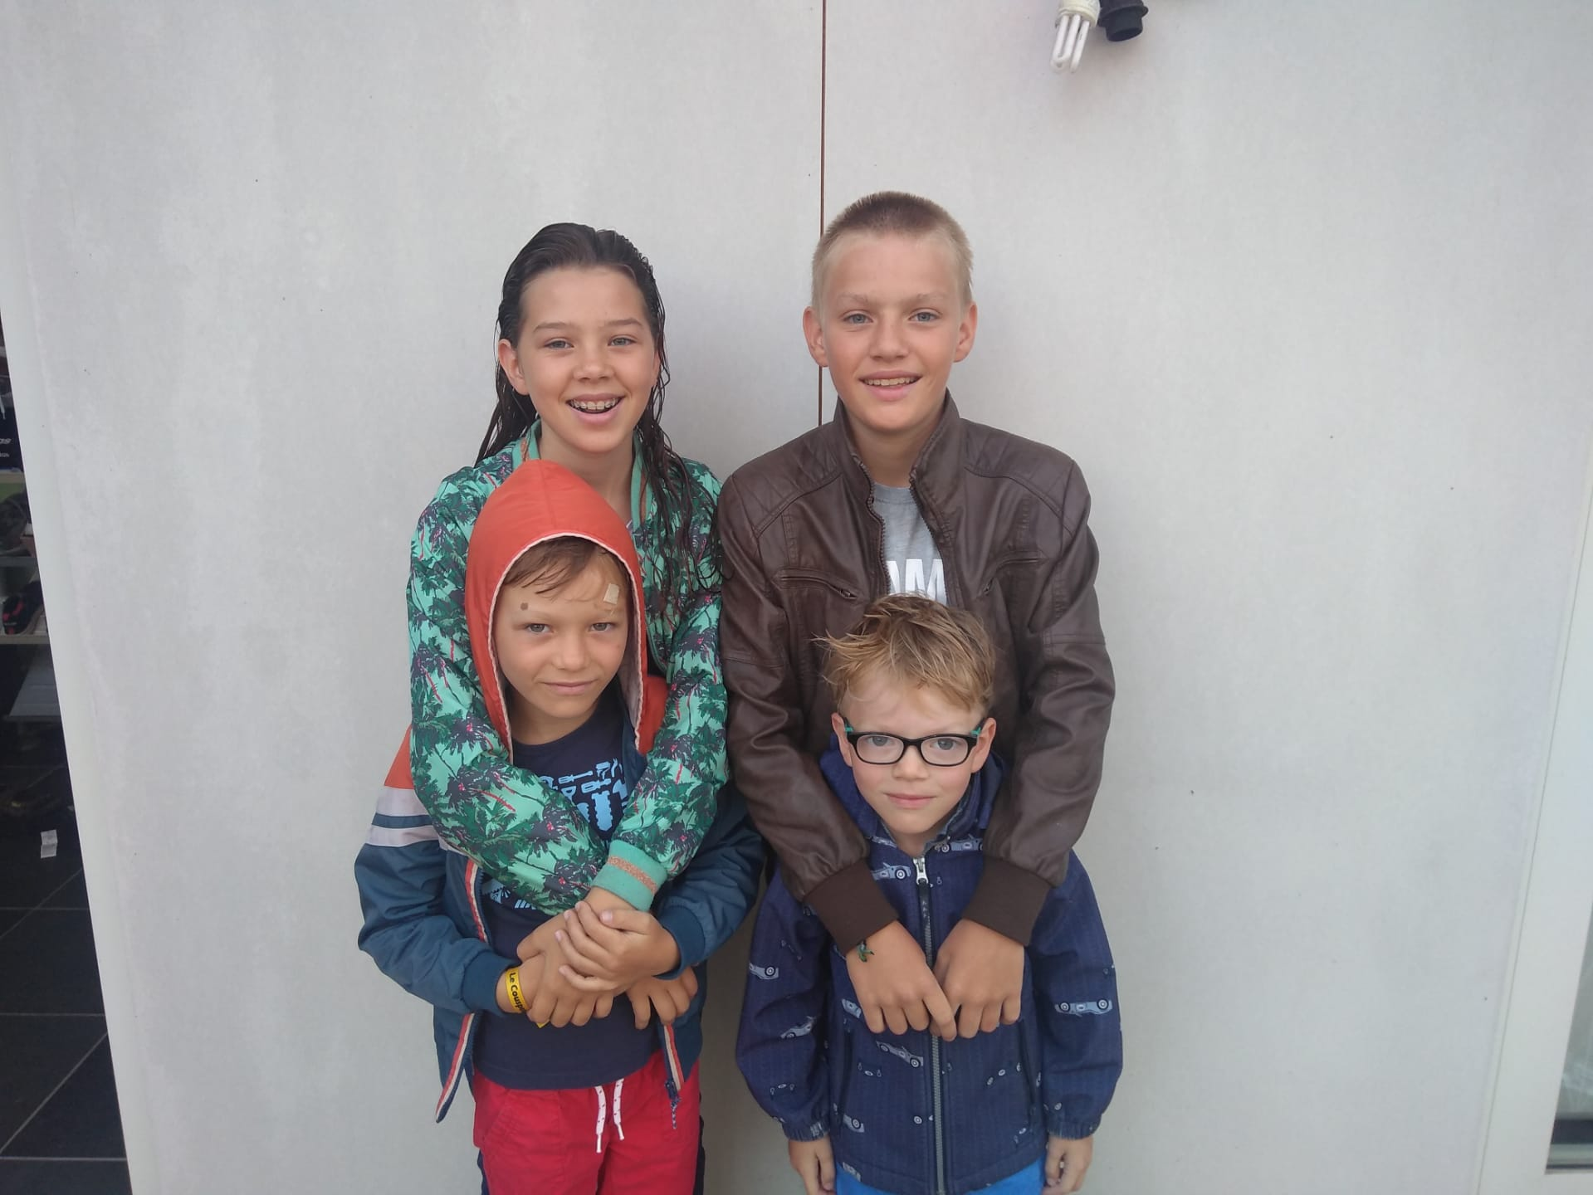
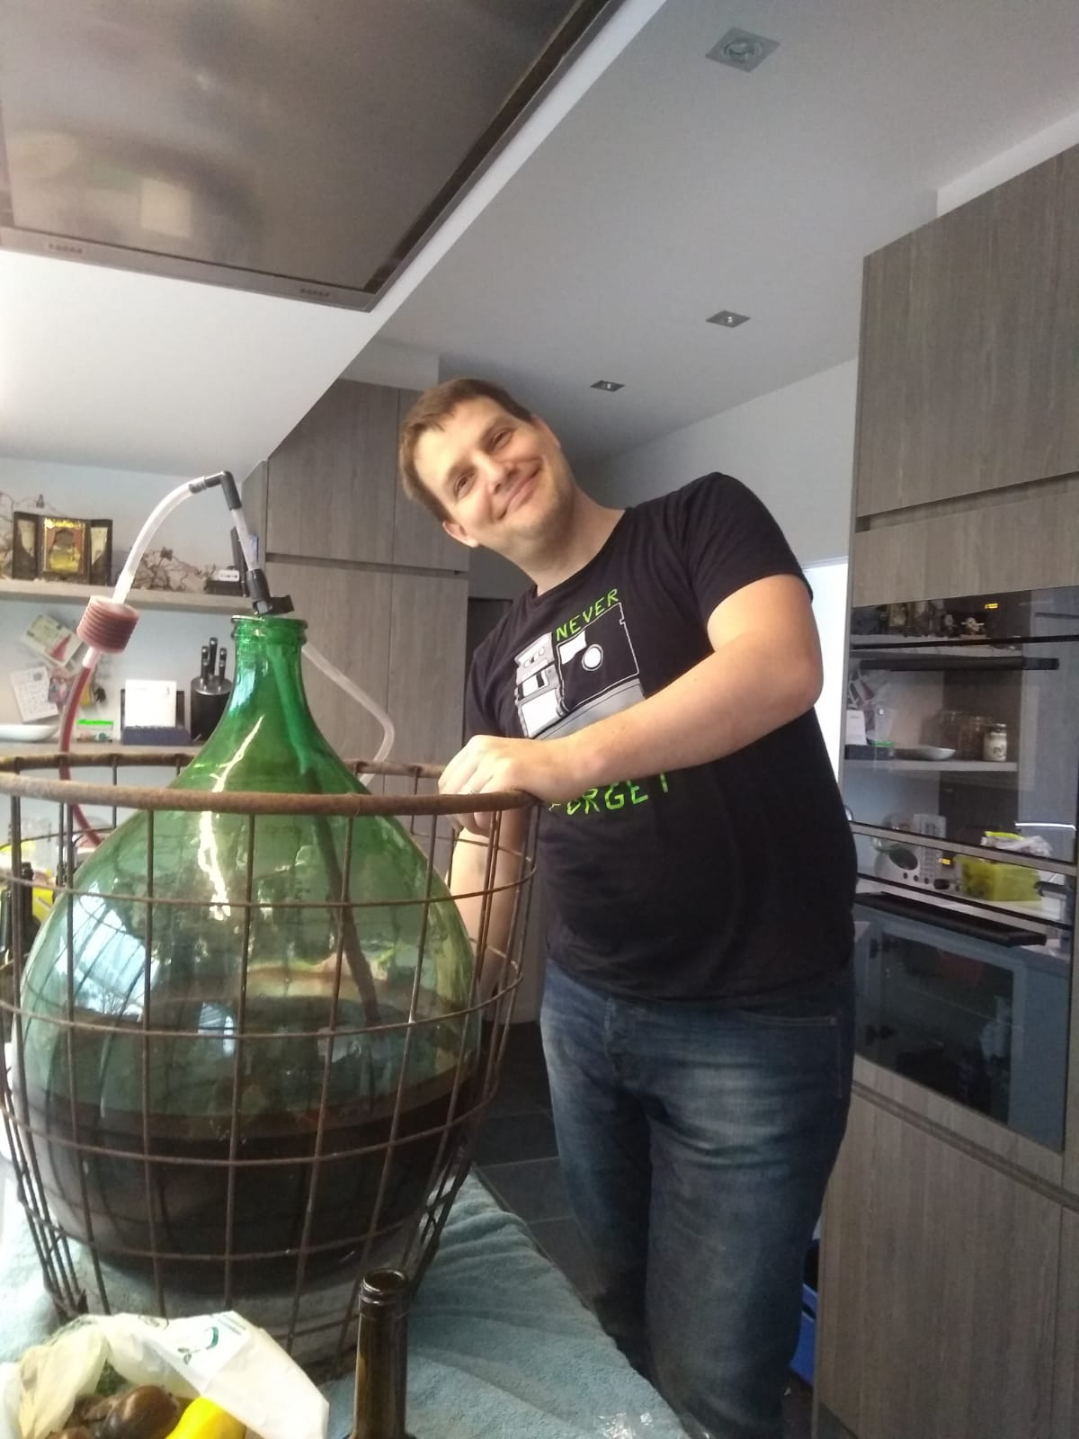

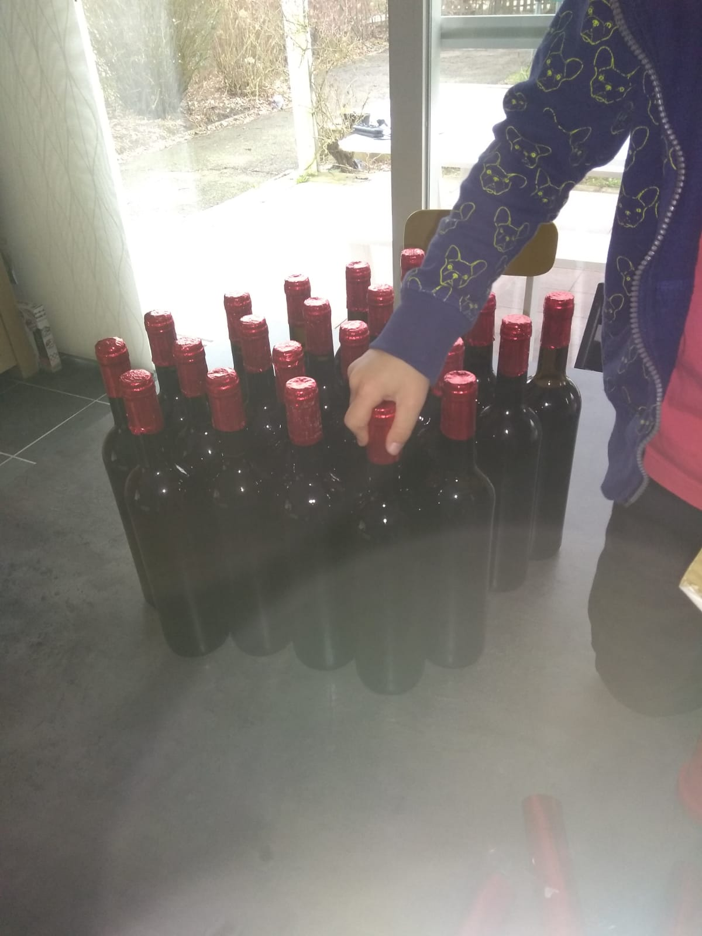

Thomas Rotté
Notes:
Thomas: I am Thomas, and i am also co-founder of Probit. I have 4 kids: Nand is 13, Sien is 11, Toon is 7 and the smallest one, Guus is only 6. Started 2 weeks ago in first grade regular school. i love technically complex things, huge fan of Quantum computing and AI. but i also love to drink beer (Duvel is my favorite). Next to that, i make my own porto, and my own wine.

Slide 5

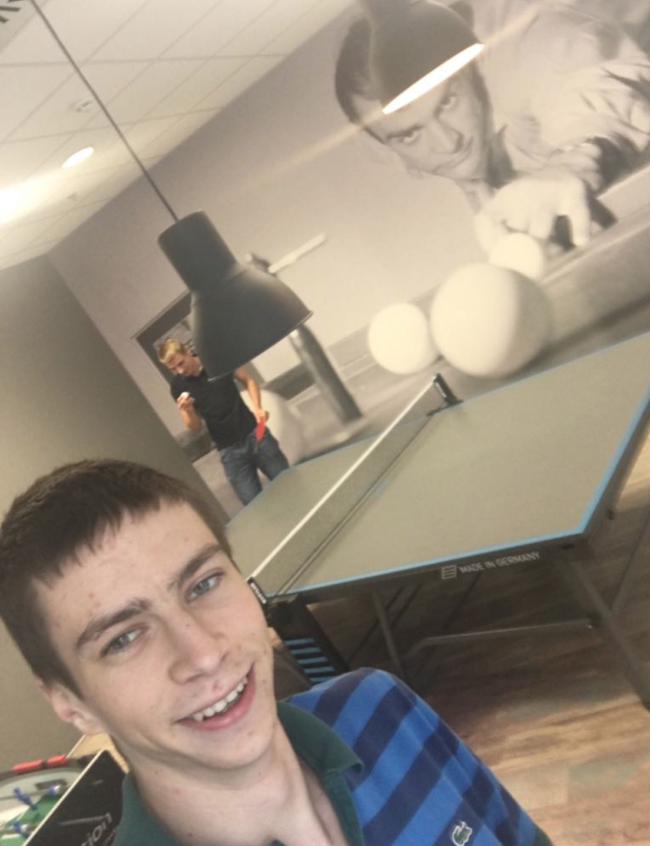
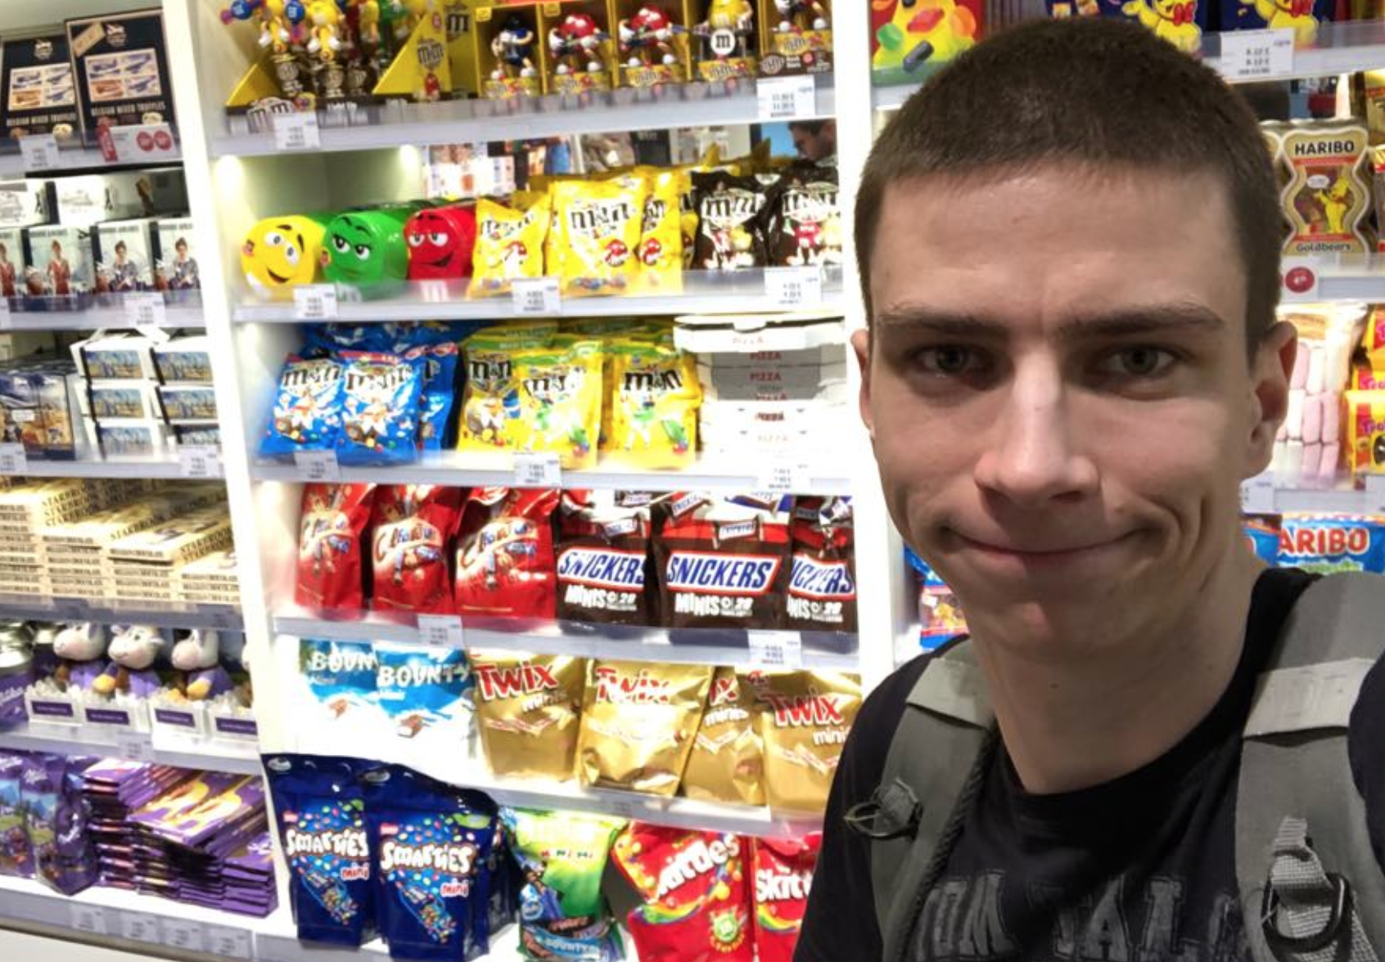
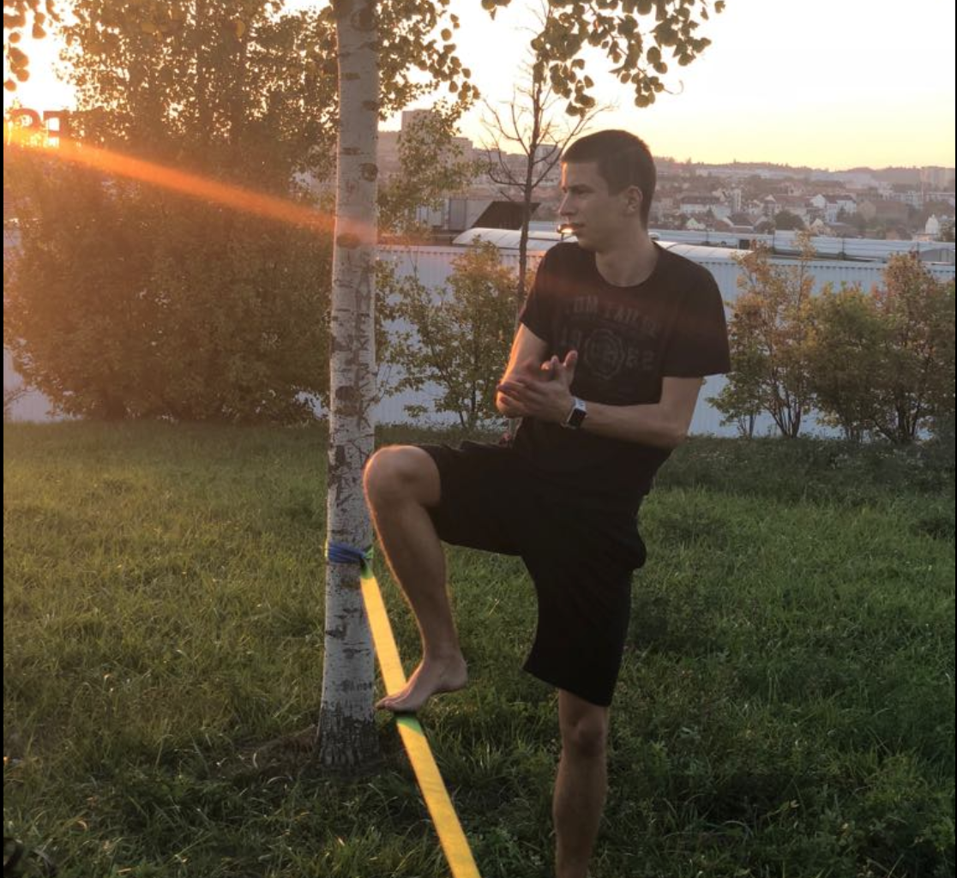
Lukas Rotrekl
Notes:
Lukas: TBD

Slide 6
What’s up with Testing?
Notes:
Lukas: So: What is up with testing… you are all familiar with the testing business…

Slide 7
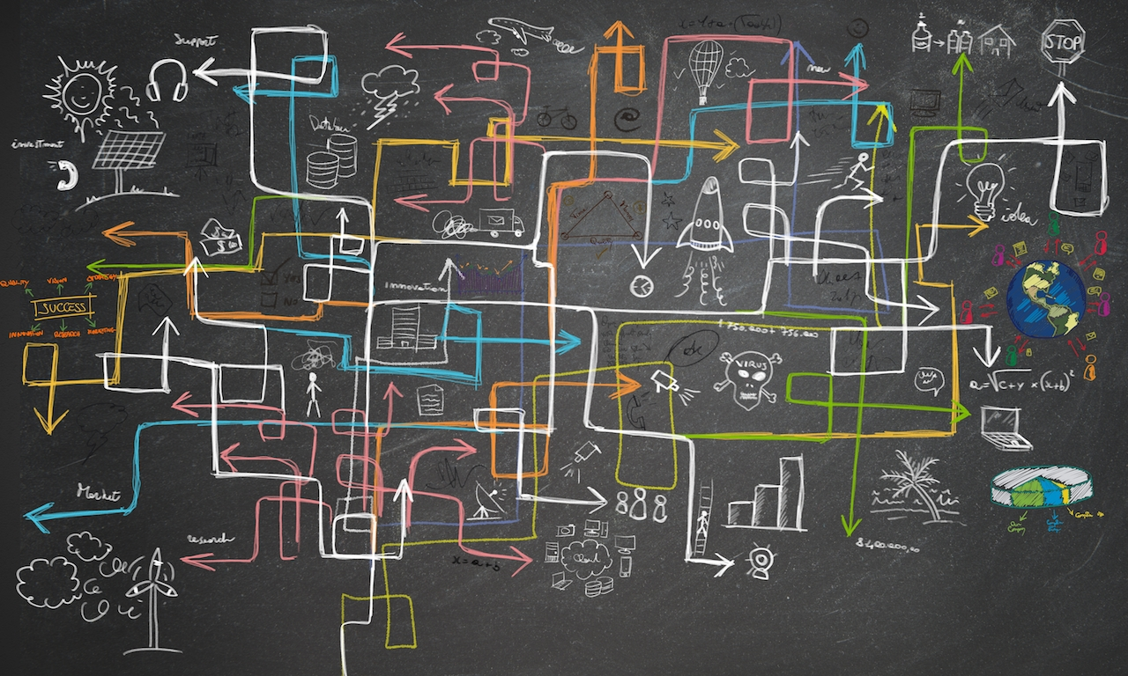
It’s complex
Notes:
Lukas: It is complex

Slide 8
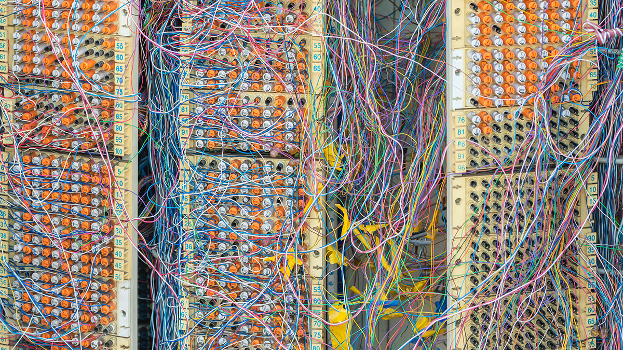
Very very very complex
Notes:
It is very-very-complex

Slide 9

No seriously… it is!!!!!!!!!!!
Notes:
Lukas: Seriously… it is tremendously complex

Slide 10
Why?
Notes:
Lukas: But why is it so complex?

Slide 11
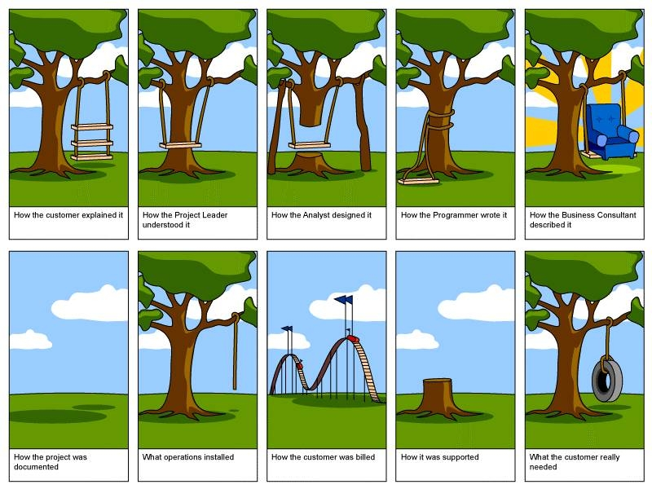
Notes:
Frederik:
Why is that, because our customer wants and needs a lot of functionality, becuase the business thinks that our customer needs all this functionality, because development tries to implement what they think the business thinks that our customers thinks they need, so in the end. All these requirements become a very complex whole.
The origin of the complexity of testing software is that software itself is not well defined. All different involved people have different views on what the software should do: Customer asks something, but this needs to be translated by a project lead, and an analyst. The way the progammer made it is then yet another thing. And not quite like the business consultant expected it to be. Thanks to documentation, we have a very clear view… than there still is the operations, the support and the actual expectation of the end customer...

Slide 12
What does that mean?
inventing scenario’s, implementing, testing, understanding
complex user behaviour -> complex BAU, what was working, was it suppose to work like that-> euh… I don’t know? How should it work… hmm it worked like that I think, but I bet it should not work like that??
Html, javascript: dev overdesigned, it’s difficult, it’s not the tool for the job. It’s the hammer and everything looks like a nail
changing customer needs, changing business, changing devs, changing frameworks, changing infrastructure needs, changing plans, changing changes, changing the changed changes, changing the change changes back to the change, changing… aaaaa my gooood when is it going to stop??????
Notes:
Thomas: So how do we handle testing… We invent scenarios, try to understand what customers need, implement that, and use it for test purposes. But as user behaviour is complex, so becomes BAU testing. How should this work; is it suppose to work as i think, did it allready work like that before? How come this works??? Extra complexity is the languages that are used for application design. Javascript is not really a language… HTML5 is just crap. you can do anything with it; but the code will never look pretty (and therefore is never maintainable).
Then we have the changes. changing customer needs… changing business, changing, devs, changing frameworkd, changing plans, changing changes, changing the changed changes, changing the changing changes back to the original changes ….. Where does this stop?

Slide 13
NEVER
Notes:
Lukas: NEVER!!!

Slide 14
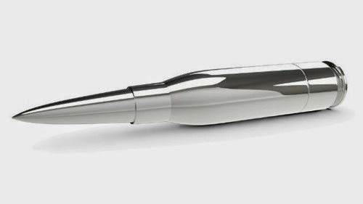
Notes:
Lukas: We need to have a silver bullet. Something that ‘changes’ the way of testing, something that solves all our issues. How to handle changes, how to handle the uttermost complexity. How to enable us to really test the application and to be sure of the quality of the delivered project without spending enormous amounts of money on it. How can we automate our test automation?

Slide 15
Probit
What does it do?
captures production actions
AI
behaviour model
Bots
BAU
Notes:
Frederik: So we came up with PROBIT: what does it do. We monitor real users in our production environment. we capture their actions. Ai turns this in a behaviour model with GDPR compliancy. The we created a framework where bots can use the behavioural patterns to construct their own tests straight from the actual behaviour. We cannot come any closer to Business As Usual.

Slide 16

This made us very enthousiastic!!!
Notes:
Frederik: This looked so promising, we were very enthousiast

Slide 17

BUT!!!
Notes:
Thomas: BUT!!!!

Slide 18
Challenges
scenarios
Validation
execution
We execute what is happening on prod and validate by means of technical error detection and by reachable and unreachable functionality
Notes:
Thomas: We had some challenges…
We monitor scenarios, actions of the users. but our monitors could not capture the brains of the user behind the keyboard. We cannot reach their intentions, and we need them to add meaningfull validations. So we started with a rubber bullet instead of a silver one. We capture scenario’s, we execute them, and validated the ‘normal behaviour of the patterns. We can alert for technical errors and we can validate that there are no unreachable scenarios.

Slide 19
On this idea we started working on it with Lukas & others
First milestone: validation that it worked:
October 2018 Probit worked
Notes:
Frederik: On this idea, we started the cooperation with Brno. Lukas and Filip were a great help with their experience, and their technical knowledge. Cooperation started just about one year ago in october 2018

Slide 20

Oktober 2018
It Works!!!
Bots run: 1 day: 5 bots, >1000 scenario’s executed
found 30 defects
Notes:
Lukas: And it seemed to work!!! in short period of time we found about 30 defects.
A lot of them were not detected by traditional test automation.
two big reasons:
we start earlier. and
we cover a bigger plain of behaviour, as the different scenarios are not written one by one, but captured from production.
we monitored all the systems: Backend errors, FE errors, midtier errors, unreachable actions

Slide 21
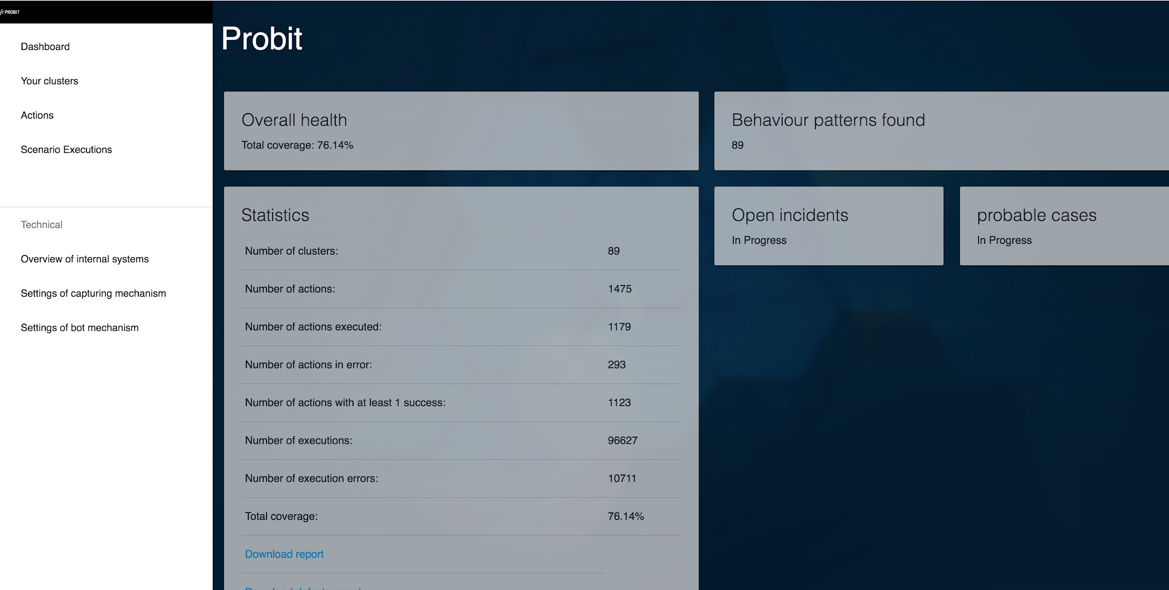
SCreenshots of probit and workings
Demo movie??
Notes:
Frederik: touch screenshits

Slide 22
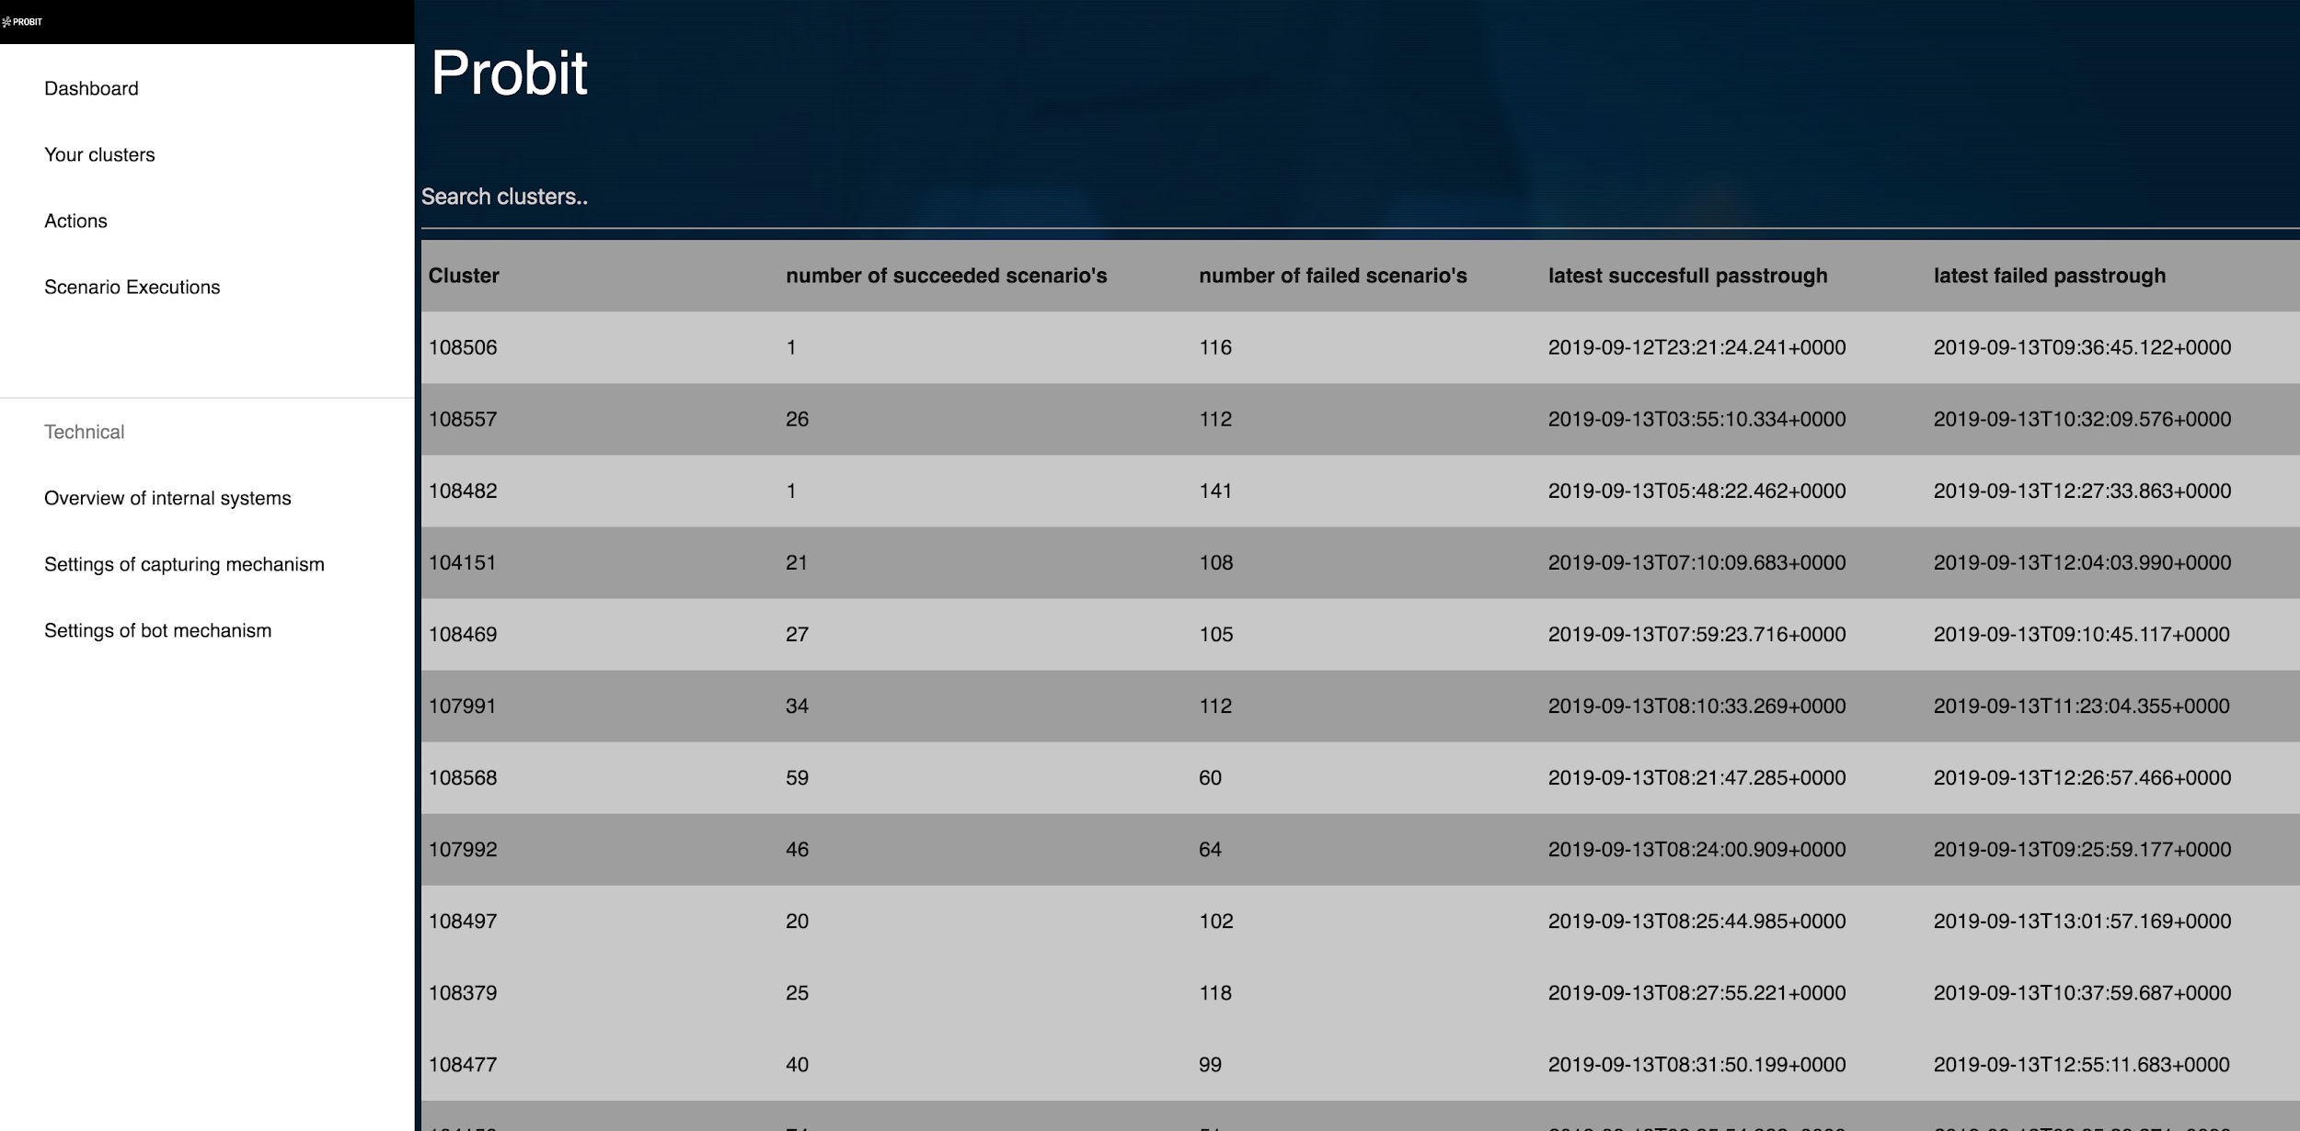

Slide 23
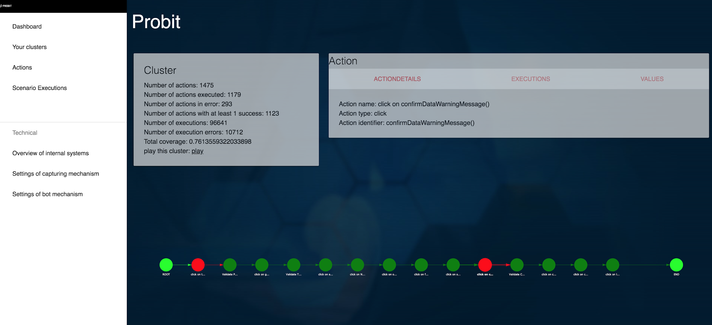

Slide 24
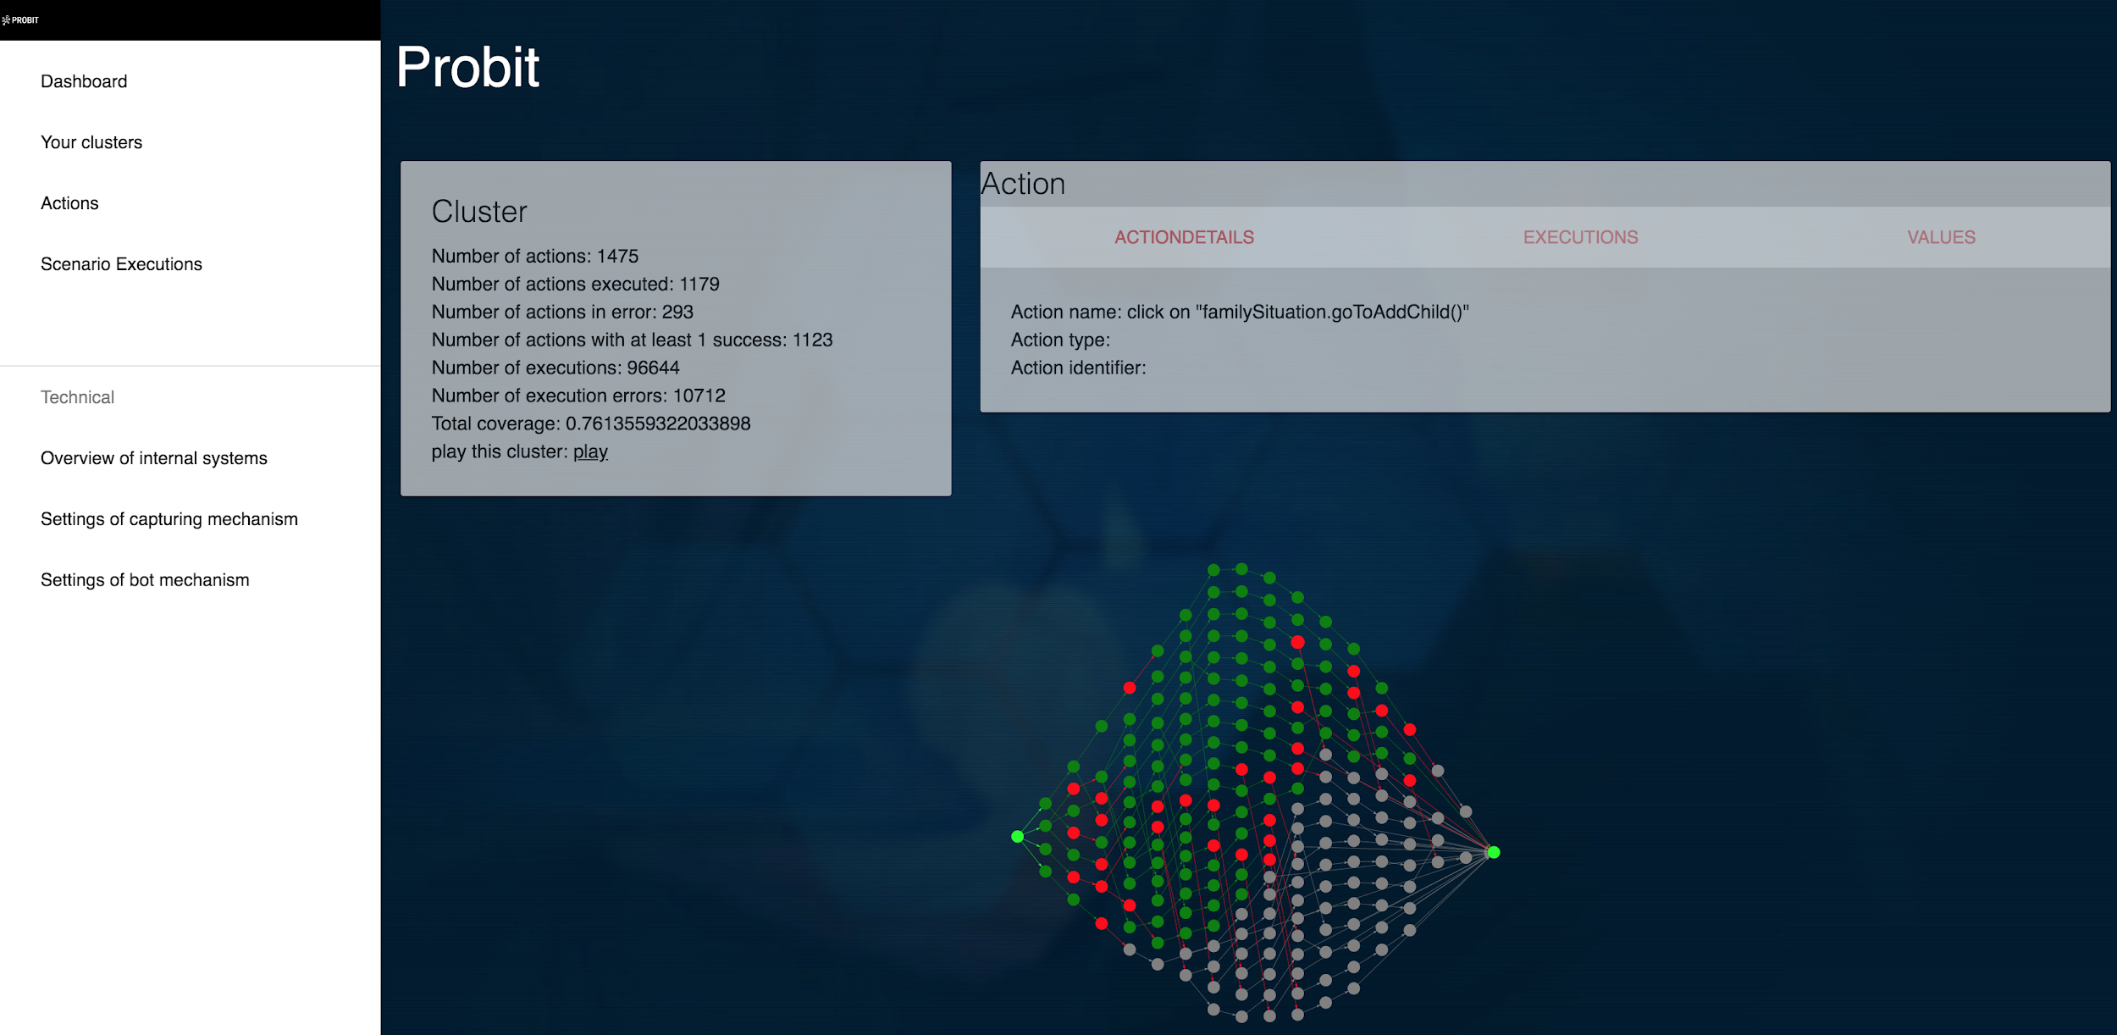

Slide 25
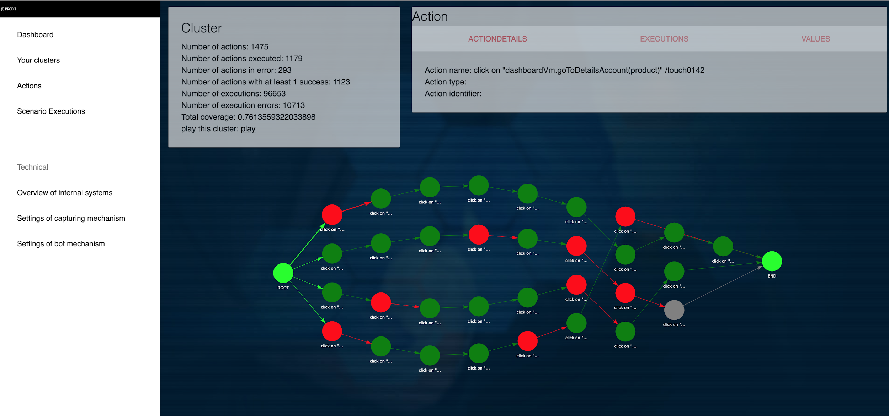

Slide 26
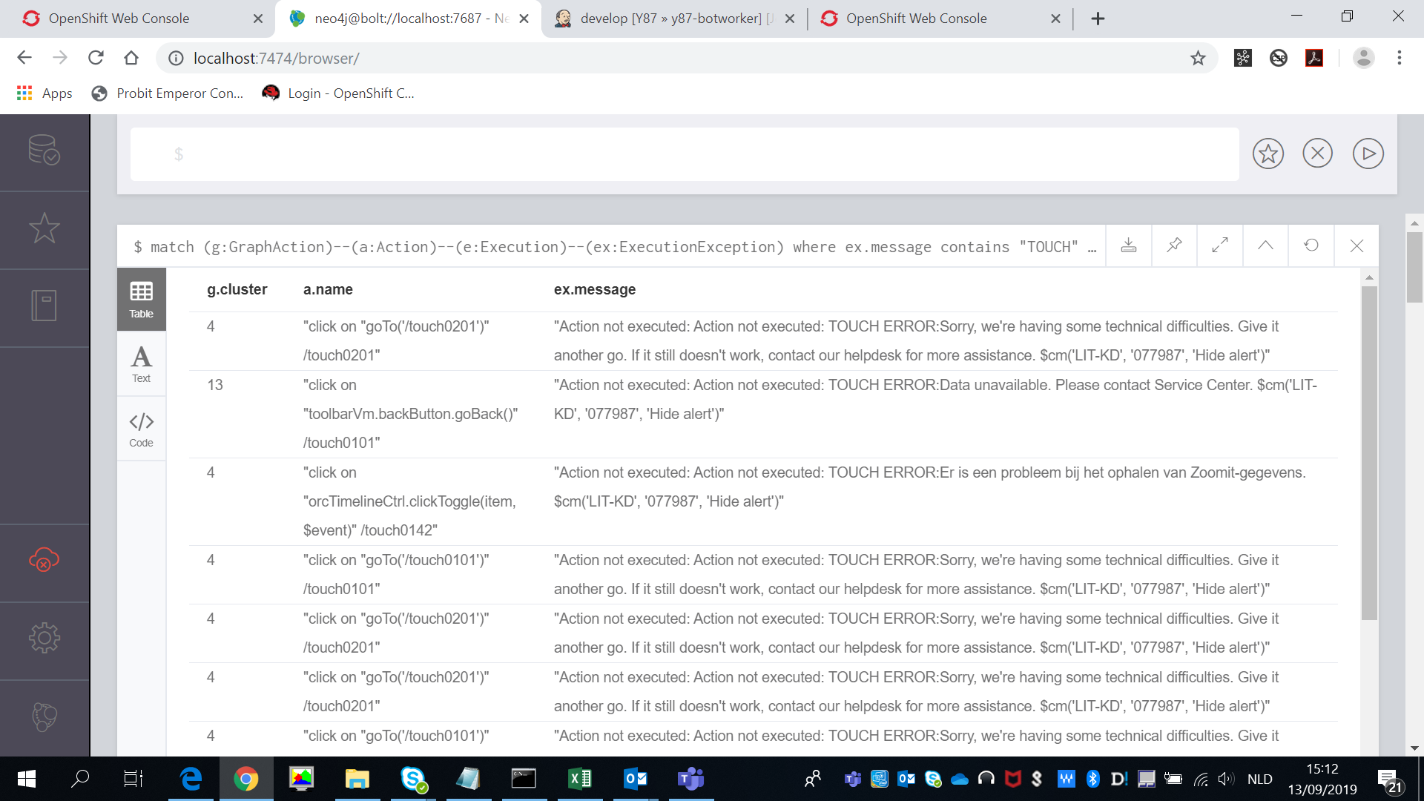
match (g:GraphAction)--(a:Action)--(e:Execution)--(ex:Exception) where ex.message contains “TOUCH ERROR”

Slide 27
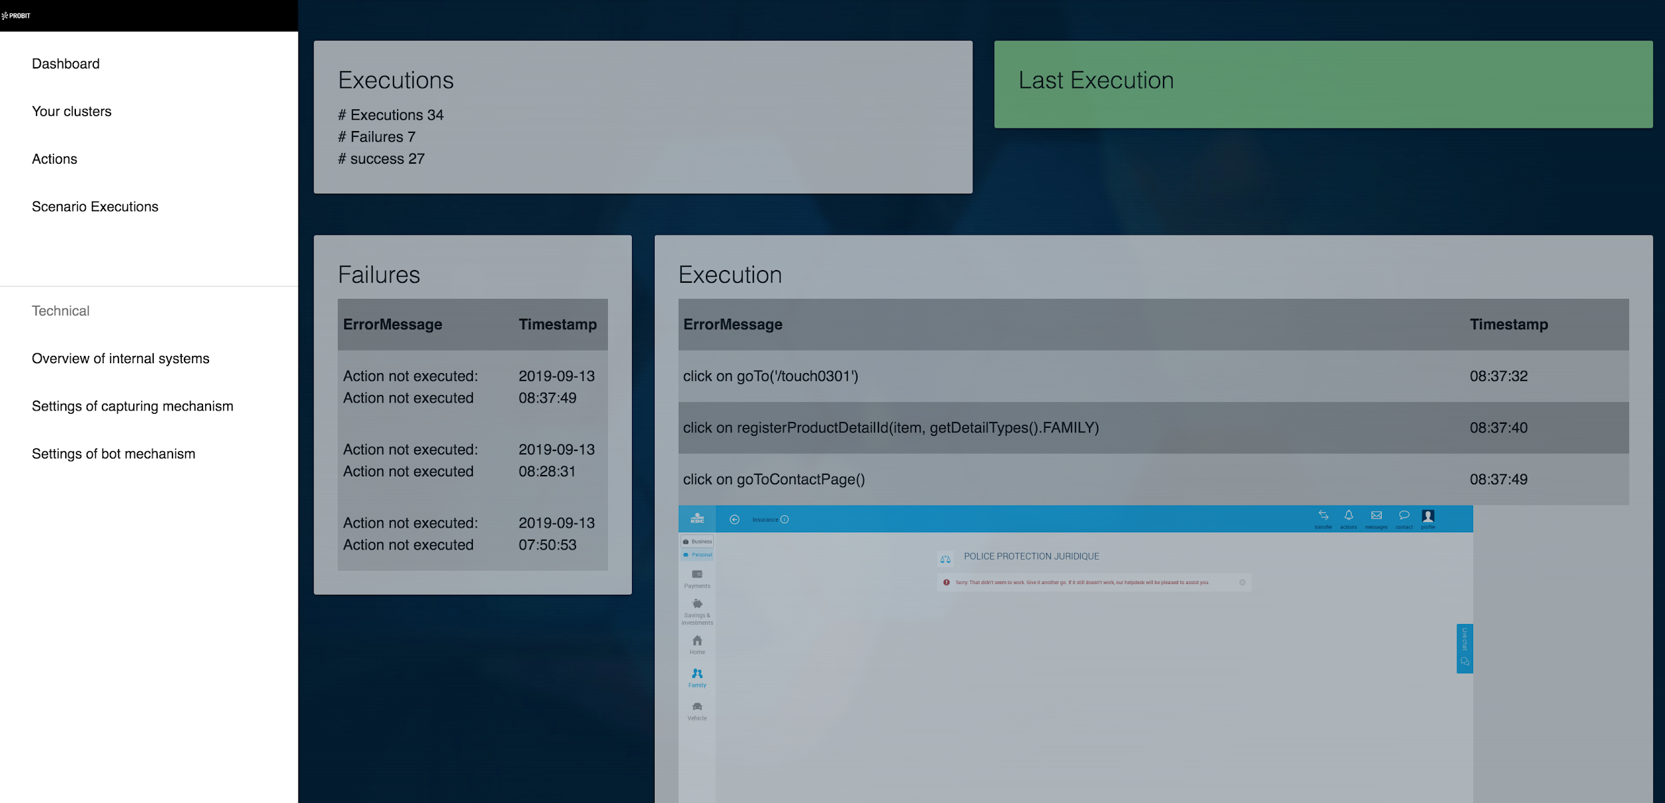

Slide 28
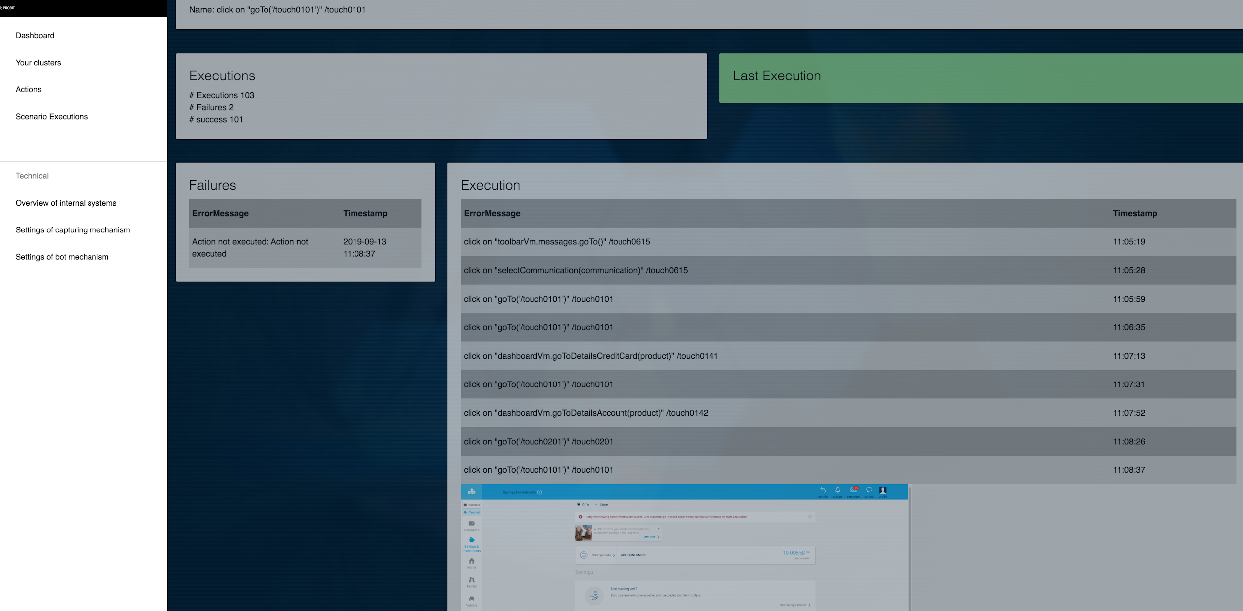

Slide 29
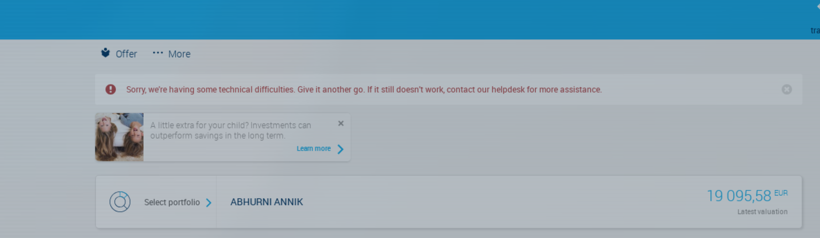

Slide 30
Set backs / challenges
Dynatrace data bad
Good release
externalisation -> focus on sales, understaffed
lost focus
Touch to complex, customized views of touch per user, to much complex functionality
Budget cuts
Result: Probit saves 1 FTE
Notes:
Thomas:
As all projects…. we had some challenges…
We used dynatrace data for monitoring… that went well, untill they changed versions, and excluded some vital probit data. we have some workarounds, but this makes it complex. The fact that Touch is very complex didn’t really help that.
Another challenge were the good releases of februari and may… even traditional test automation found very few defects. But this was percieved by some people as probit didn’t find enough.
We had some budget issues. As the budget was short at KBC, we tried to look for sales outside the bank. this worked, but this made us loose focus on the actual business of Probit. the test automation itself.
Conclusion: Probit works, but the automation is not that big. currently, Probit automates the BAU work of one employee that can now focus on more challenging things to do.

Slide 31

The future
Uncertain
We believe:
Analysis report, gradually automate probit
first it will not deliver high value, but automate bit by bit by bit. Very complex material
Notes:
Lukas: So whats the future…
We at brno, and Thomas and Frederik, believe that there is a benefit in using Probit. Plans are to continue to automate, and improve bit by bit. Other participants in this project are welcome!

Slide 32
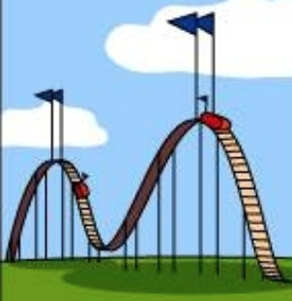
Closing remarks
Lesson in entrepreneurship:
DO IT!
High’s and lows
Worked, we got success, issues, personal issues,
again success, sales,
more issues. It’s an emotional rollercoaster
Jef Staes
Notes:
Frederik:

Slide 33
The end

Slide 37
What should we have done
Sell service: testing report every week with investigation of possible BAU defects
Lower price: 1000 euro/month
Smaller customer: 50 -> 1000 employees
Focus more: define targets on all topics: dev, sales and business
bigger team
Full devotion of the team

